Slide 1

MVR Positive Spike Alerts

Slide 2

Overview
In general, the MVR Spike Alerts model will monitor each report on a weekly basis:
Trend & Threshold: calculate a high value alert threshold based on prior 12 weeks transaction trend
Alerts: detect reports have extremely high transaction units
Our Brand Essence
We believe in the power
of data and advanced analytics for better risk management.
Our Brand Promise
Transform your risk decision-making.

Slide 3
Modeling Population Waterfall
From 04/29/2019 Monday to 10/27/2019 Sunday (25 weeks total)
From 484 companies
Including 51 states
74,874 MVR reports

Slide 4

Raw Data Population Waterfall
All MVR Reports
(74,874 reports)
Drop reports with 7 weeks total units smaller than 400
70,159
Drop reports have “unassigned company”
28
Qualified Reports
4,687
Notes:
For government, there are 11,573 subaccounts, we need to drop 4,847 attrited subaccounts, then we also need to drop 235 outliers, then the final qualified subaccounts for further cluster analysis is 6,491.
Attrited means: where v.vertical_market_gen01 in ('GOVERNMENT RISK') and ca.cy_vertical_sk in (7,8,9,54,55) and ca.hh_id not in (0) and ca.subaccount_attrition_year_month < 1 and ca.src_cancel_dt <= 0
and ca.subaccount_status = 'Active'
Outliers means: subaccounts have high revenue and 0 usages… There are 235 accounts have high revenue(greater than the overall median revenues) and 0 usages

Slide 5

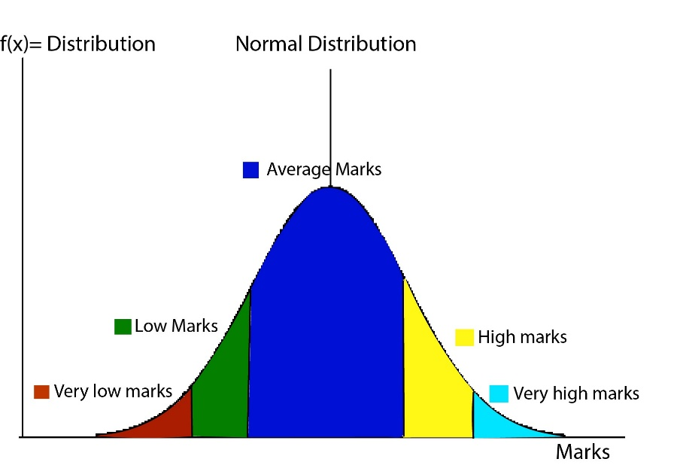
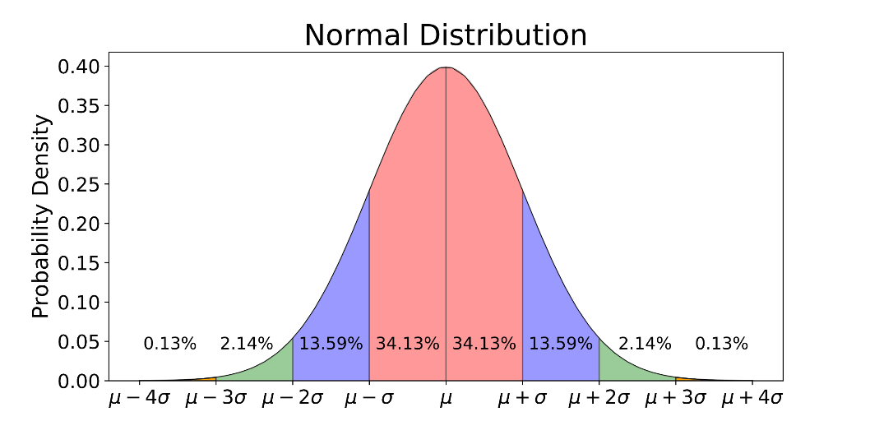
Statistics Behind the Model
Our Vision
To inspire insightful decisions in a world of hidden risks and opportunities.
Our Mission
To provide essential insights to advance and protect people, industry and society.
μ is the average amount of variation of a set of values
σ is the standard deviation measure of the amount of variation of a set of values

Slide 6
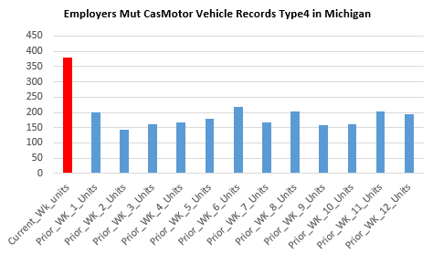
Statistics Behind the Model
Example
Our Vision
To inspire insightful decisions in a world of hidden risks and opportunities.
Our Mission
To provide essential insights to advance and protect people, industry and society.
μ + 4σ (alert threshold)
μ
Current week units: 381
12 weeks average units: 179.75
12 weeks units standard deviation: 23.53
4 times of standard deviation above average: 273.87
Alert: 381 > 4σ(273.87)
Please note: current week is 10/21/2019 to 10/27/2019
Prior 12 week is 7/29/2019 to 8/4/2019

Slide 7
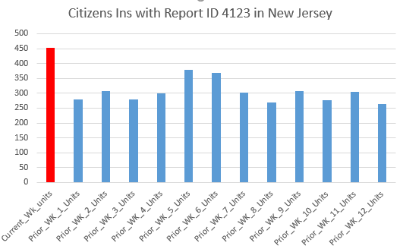
Statistics Behind the Model
Dilemma: 4σ or 4σ?
μ + 5σ
Our Vision
To inspire insightful decisions in a world of hidden risks and opportunities.
Our Mission
To provide essential insights to advance and protect people, industry and society.
μ + 4σ
μ
Current week units: 453
12 weeks average units: 302.75
12 weeks units standard deviation: 36.02
4 times of standard deviation above average: 446.85 times of standard deviation above average:482.87
Alert: 453 > 4σ
Non-Alert:453 < 5σ
Please note: current week is 10/21/2019 to 10/27/2019
Prior 12 week is 7/29/2019 to 8/4/2019

Slide 8
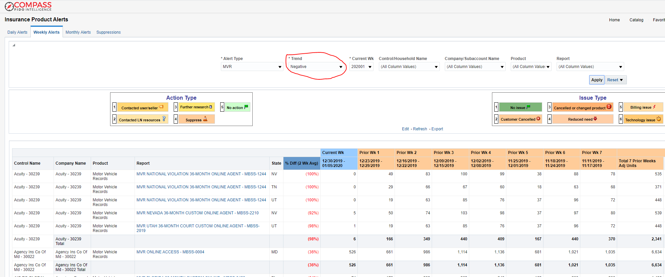
Compass Dashboard Overview

Slide 9

MVR Positive Spike Alerts
Cater to every unique report
Each report has its trend and high transaction units threshold
Current week value vs. previous two-week value
Prior 7 weeks total units value
Filters – multiple filters included in the dashboard to refine what you want to see
Company control name
Company name
Report ID
State
Previous 7 weeks transaction value

